Slide 1

Python Class 18
your own project

Slide 2
Some ideas
A text adventure game. The text can be written in Japanese.
An app that tracks something – hours that you study, hours that you practice a hobby, times that you watch Youtube, how many hours you sleep each day, your test or homework scores, books you’ve read, games you’ve played, etc.
A review quiz app – an app that helps you study or review a subject.
Any other ideas you can think of!!!!

Slide 3
Calendar
In college, I made a calendar conversion program – you had a list of different calendars, and you entered a regular date. The program would convert the date into the calendar you selected.
For example, July 19, 2022 is Confusion 54, 3188 in the Discordian calendar. (There are 5 seasons, no months, and the first year starts on January 1, 1166 BC.)
Or using the French Revolutionary calendar, it is Thermidor 1, 233. (12 months, starts on September 19/20/21 (autumn equinox) 1789)

Slide 4
Text Adventure
Voldemort wins
Gryffindor
Best friend?
Ron
Harry dies
Slytherin
Hermione
another choice
What house?
Ron dies
Ravenclaw
What is …?
another choice
Hogarts is destroyed
Better to be fair or loyal?
Hufflepuff
Fair
another choice
Everyone is safe and happy, even Voldemort
Loyal

Slide 5


Slide 6
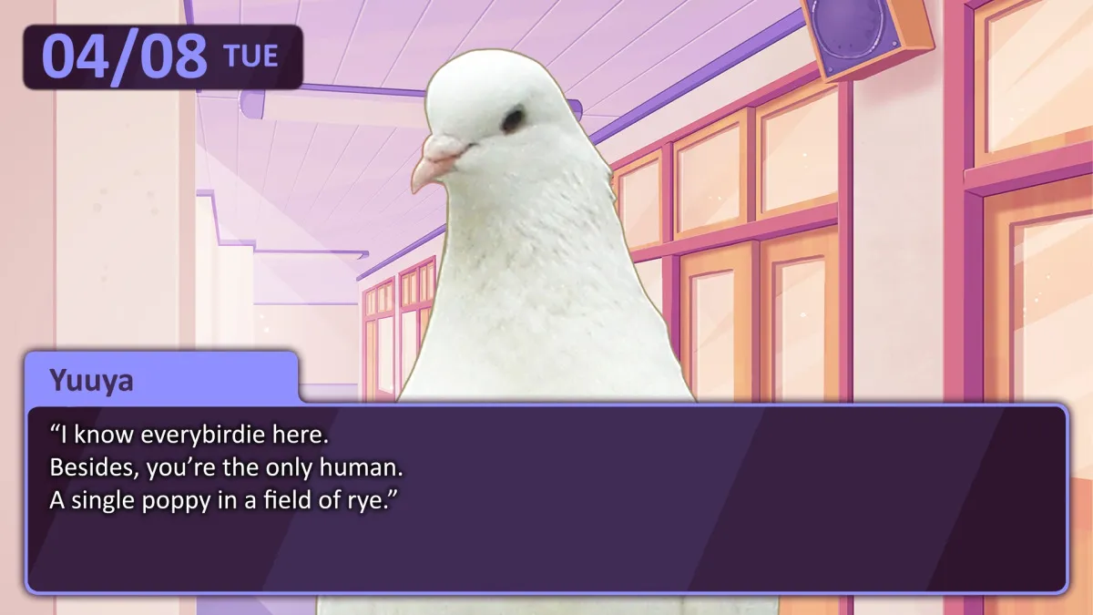

Slide 7
Recipes
Last year, we made a recipe holder project together.

Slide 8
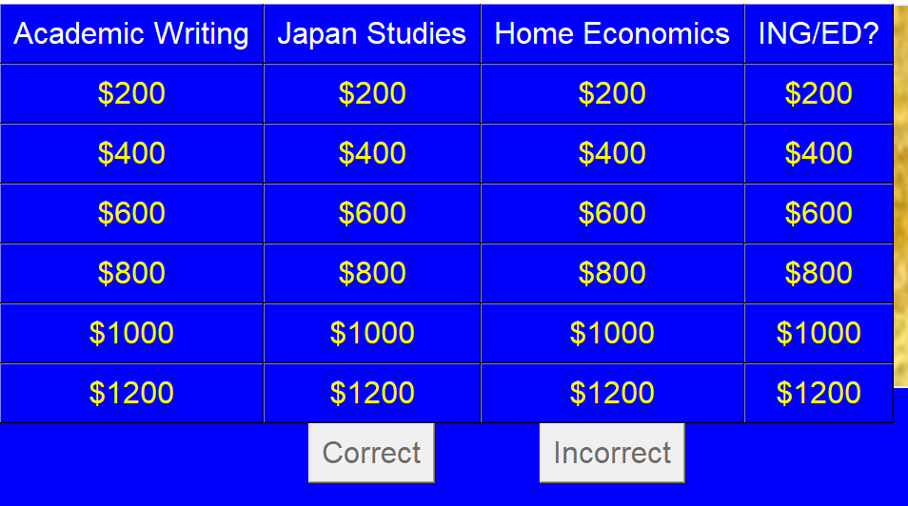
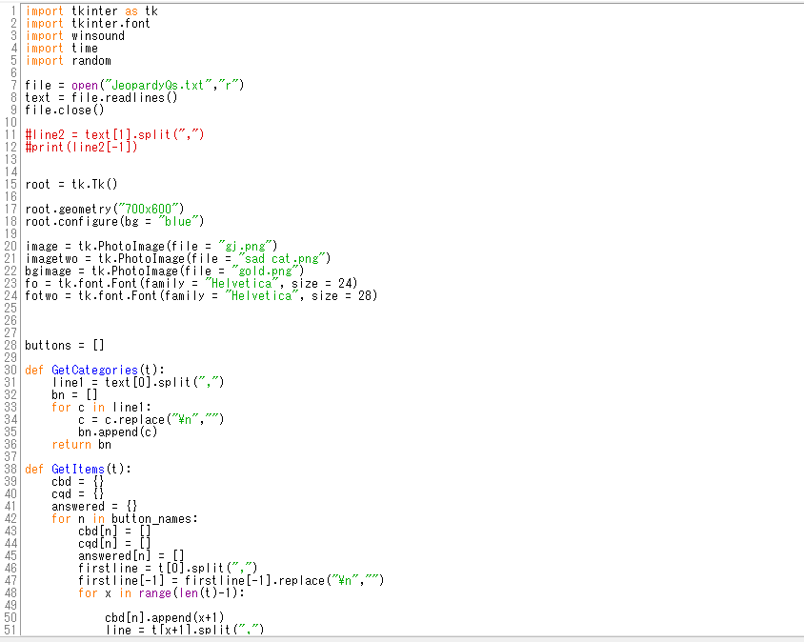
Graphical Quiz Game using tkinter

Slide 9
Text quiz game
What is the capital of Canada?
Toronto
Sorry, no. Try again.
Ottawa
Great job!
import random
questions = [“What is the capital of Canada?”,…]
answers = [“Toronto”,…]
correct_answers = 0
# we should probably load the questions and answers # from a file
correct_responses = [“Good job”, “Nice work!”…]
incorrect_responses = [“Try again.” , “Sorry, no.”…]
#pick a random question
#check if the user’s answer is correct

